Slide 1

SAP Mobile Training
SAP UI5 Introduction
BPSE Consulting Pty Ltd | ABN 39 123 457 769 53 | Walker Street, North Sydney NSW 2060 Email: info@bpse.com.au | Office: +61 2 9045 0238 | Email: info@bpse.com.au | www.bpse.com.au

Slide 2
Agenda
Section
SAP Fiori an introduction | 15 mins
Intro to JavaScript, HTML, CSS, Git | 30 mins
Ex. 1 – Build your first App | 15 mins
Object Orientated JS | 15 mins
Ex. 2 – Manipulating Data in Arrays | 30 mins
JQuery & JSON Overview | 15 mins
Ex 3 – Show data in JQuery control
Odata – Open Protocol Fundamentals | 15 mins
Ex 4 – Using REST Client
DataJS – Combining Data with JS | 15 mins
Ex 5 – Connect to an Odata source using DataJS
SAP UI5 incl Data Binding | 30 mins
Ex 6 – Connect to a SAP Odata source | 30 mins

Slide 3
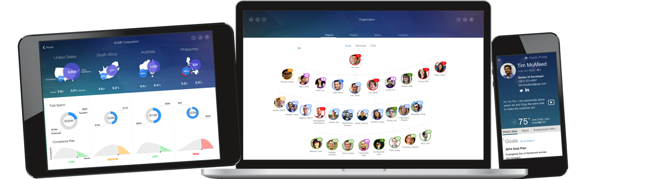
Rule of the course
«ENJOY & HAVE FUN !»

Slide 4
SAP Fiori – an introduction
A design pattern delivered by SAP

Slide 5
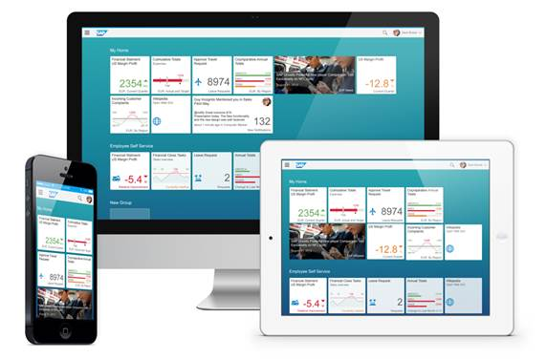
SAP FIORI
A collection of apps with a simple and easy to use experience for broadly and frequently used SAP software functions that work seamlessly across devices – desktop, tablet, or smartphone.

Slide 6
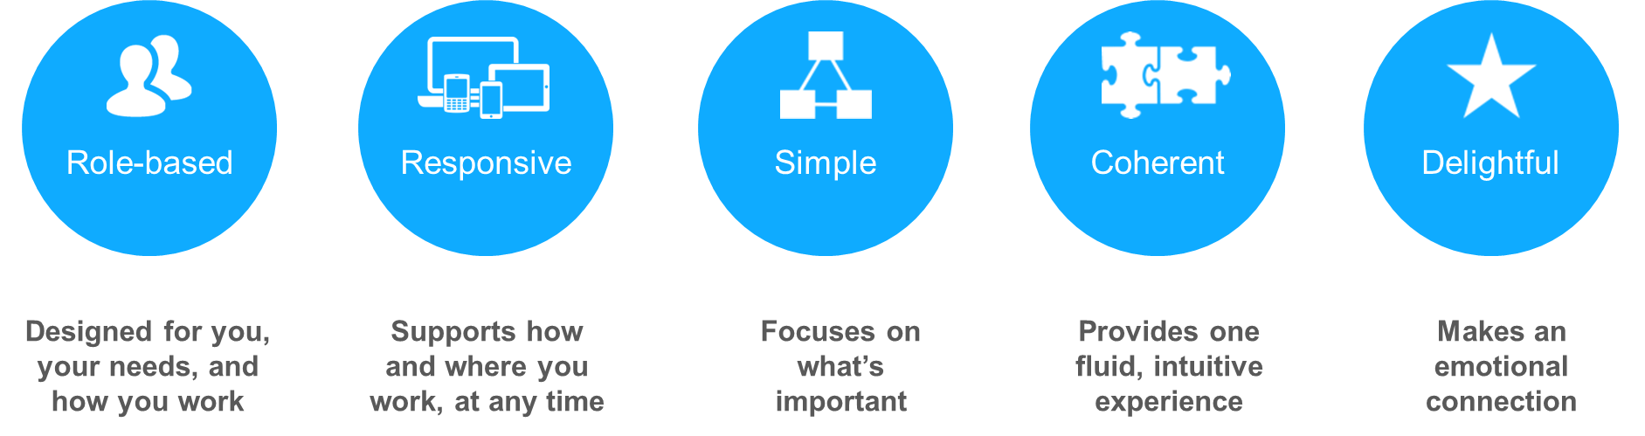
SAP Fiori UX Design Principles
Objective of this course is to be able to build “Fiori like” applications.
It is always a good idea to look at existing applications to see the design patterns that are employed.
Notes:
Here is a link to all the sample applications, that developers and analysts should review to help with design of their own application:
https://fioriappslibrary.hana.ondemand.com/sap/fix/externalViewer/#/detailInfo
Here is a link to the Fiori Prototyping kit:
https://www.dropbox.com/s/j23hlkjddbhmmp0/Prototyping_Kit.pptx?dl=0

Slide 7
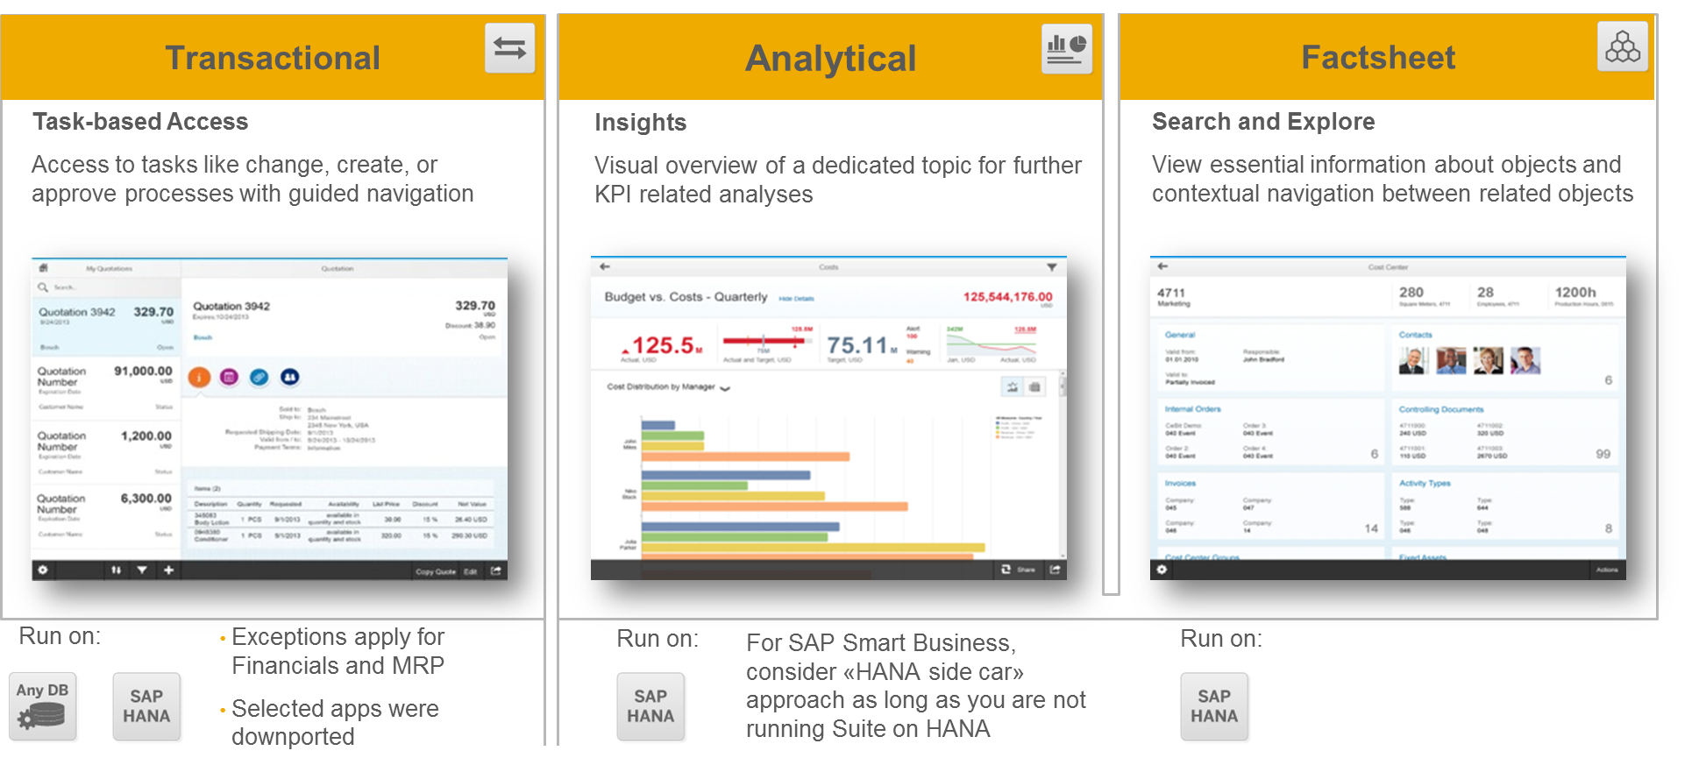
FIORI APPLICATION TYPES

Slide 8
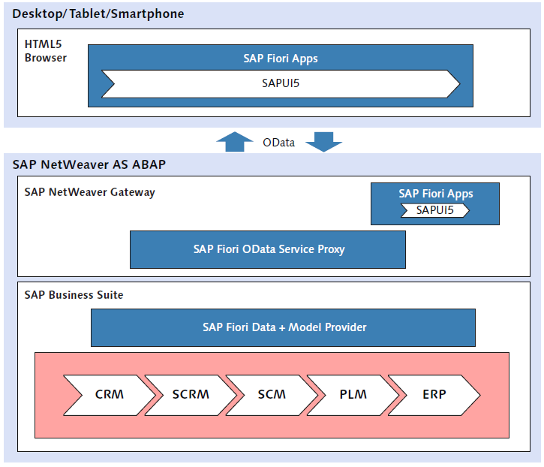

FIORI ARCHITECTURE

Slide 9
Intro to JAVASCRIPT
Grasping the basics

Slide 10
HTML
HTML applications is a web application that can easily run on any web browser.
Why would we use HTML applications as an approach to mobile development?
Takes advantage of web development resources.
Takes advantage of industry-standard developments tools and tool chains.
Allows easy cross platform build, support and deployment.

Slide 11
HTML Overview
HTML is a definition language used for the structuring and schematic markup of content such as text, images, hyperlinks and documents.
The content of an HTML document consists of HTML elements.
HTML elements are marked by tags.
Start tag: <__> signals the browser of a section to follow.
End tag: </__> signals the browser a section has ended.
The area between these two tags are for the actual content of the HTML element.
Ex: <p> Text in a paragraph section</p>
<p> signals browser that a section paragraph will follow.
</p> the paragraph section has ended

Slide 12
Framework of a HTML Document
<!DOCTYPE html>
<html>
<html>
Document type declaration
<head>
<meta charset = “UTF-8”>
<title>First Page</title>
</head>
Header area
<meta charset = “UTF-8”>
Character encoding:
Instructs browser to display special character correctly
<body>
<!—Page content-- >
</body>
Document body

Slide 13
The Header
The following can be contained within the header:
Metadata such as the character encoding
Logical connections and links to other resources.
Style sheet definitions through out the document.
Areas for JAVASCRIPT code.
Example: Basic SAPUI5 page:
Metadata:
X-UA-Compatible – settings for document compatibility mode in internet explorer.
edge- Highest mode available
<head>
<meta http-equiv=“X-UA-Compatible” contant=“IE=edge”>
<script src = “resources/sap-ui-core.js”
id=“sap-ui-bootstrap”
data-sap-ui-libs=“sap.ui.commons”
data-sap-ui-theme=“sap_goldreflection”>
</script>
</head>
Path to Javascipt library

Slide 14
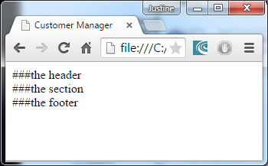
The Document body
The body can be further sub divided for logical structuring.
The structuring are done using the following tags:
<body>
<header>
###the header
</header>
<section>
###the section
</section>
<footer>
###the footer
</footer>
</body>
These dividers has no visual effect, they are only for semantic separation

Slide 15
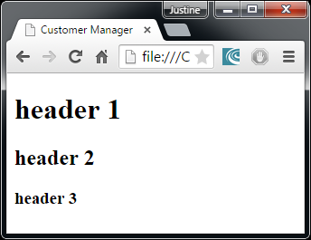
Language elements
<h1> header 1 </h1>
<h2> header 2 </h2>
<h3> header 3 </h3>
Headings:
<h#>this heading</h#>
# - level of heading
Paragraphs:
<p> paragraph </p>
Other:
Headings:
<h#>this heading</h#>
# - level of heading
Headings:
<h#>this heading</h#>
# - level of heading
Element | HTML Tag
Line Break | <br>
Ordered lists | <ol>
Unordered lists | <ul>
List entries | <li>
Block quotes | <blockquote>
Horizontal lines | <hr>
General areas | <div>

Slide 16
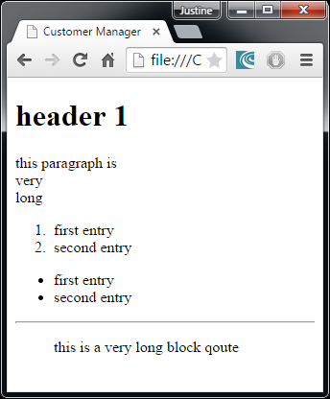
Example language elements
<p> this paragraph is <br>
very <br> long </p>
<ol>
<li>first entry</li>
<li>second entry</li>
</ol>
<ul>
<li>first entry</li>
<li>second entry</li>
</ul>
<hr>
<blockquote>
this is a
very long
block qoute
</blockquote>

Slide 17
Language element – Areas <div>
<body class=“sapUiBody” role=“application”>
<div id=“content’></div>
</body>
Complete SAPUI5 page displayed in a container with id = contained
<body>
<div style = “position:absolute; width:300px; height:150px; top:100px;
z-index:2; border:1px solid#000000;
background-color:green”>
Division in green by z-index:2
</div>
<div style = “position:absolute; width:300px; height:150px; top:100px;
z-index:1; border:1px solid#000000;
background-color:grey”>
Division in grey by z-index:1
</div>
</body>

Slide 18
Text Markups
Text Markup | HTML Tag
Hyperlink | <a>
Bold | <b>
Italic | <i>
Highlighted | <em>
Hyperlinks can be used for navigation:
<a href=“#top>go to top of page</a>
Navigate to specific parts of document:
<a href=“#paragraph 1”>go to paragraph 1</a>
--
<h1 id=“paragraph 1”>Parapraph 1</h1>
Hyperlink may link to:
another page:
<a href = “http://www.sap.com”> SAP Homepage</a>
email:
<a href = “mailto:emailadress”>email</a>
any other source:
<a href = “textdoc.txt” type=“application/notepad”>text document</a>

Slide 19
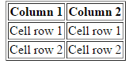
Tables
<table border=“1”>
</table>
Table element
<thead>
</thead>
Table header
<tr>
<th>Column 1</th>
<th>Column 2</th>
</tr>
Content for the header
a Table row
<tbody>
</tbody>
Table body
<tr> <td>Cell row 1</td>
<td>Cell row 1</td>
</tr>
<tr> <td>Cell row 2</td>
<td>Cell row 2</td>
</tr>
Content for the body

Slide 20
Methods
GET
The browser attaches the form data to the specified URL in the form.
The transferred data is displayed in plain text in the address bar of the browser, thus the get method is only suitable for transferring data to a limited extend.
POST
Parameters are provided via a standard input channel.
The method used in the following slide is the get method

Slide 21
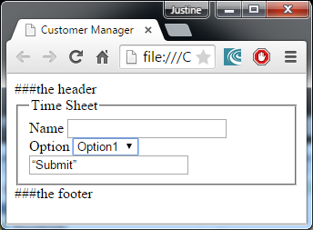
Forms
<form method=“get” action=“http:tergetserver”>
</form>
Define the form in HTML
Allows interaction between user and application
<fieldset id=“timesheet”>
<legend>Time Sheet</legend>
<label for=“name”>Name</label>
<input type=“text” name=“name”>
<br>
<label for=“option”>Option</label>
<select name=“option” size=“1”>
<option value”option1”>Option1</option>
<option value”option2”>Option2</option>
</select>
<br>
<input type=“submit” value=“Submit”>
</fieldset>
Method: specify how the browser should send the data to the URL specified under action

Slide 22
Elements of a form
Element | Syntax | example
Label | <label> | <label for=“name”> Name</label>
Input fields | <input> | <input type=“number” name=“hour” min=“0” max=“8” id=“hours”>
Text areas | <textarea> | <textarea name=“def” rows=“3”></textarea>
Selection lists | <select> | As in previous slide
Dropdown lists | <datalist> | As in previous slide
Radio button | <input type=“radio”> | <input type=“radio” name=“radio”>

Slide 23
Introduction to CSS – Cascading Style Sheets
CSS contains information about the style such as the color fonts and positions.
The content is structured by HTML and styled by CSS.
General Structure
Selector{
}
The Selector determines to which HTML element the style applies
Characteristic: value;
Characteristic: value;
…
Declaration:
The first part of the declaration indicates the property to be designed, the second part is the value.

Slide 24
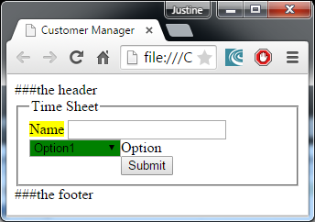
Integrating CSS in HTML
Link the CSS file containing all the css codes via a hyperlink in the header
Integrate the CSS into the header of the HTML document
Ex:
Integrate the CSS inline at the relevant HTML tag.
Ex:
If more than one style is applied to the same element, the last rule will take priority since it was declared last
<link href=“style.css” rel=“stylesheet”/>
<style type=“text/css”>
select {
width: 100px;
float: left;
background-color: green;
}
</style>
<label for=“title” style=“color: green;”>Title</label>

Slide 25
Selectors
Type | Definition | Syntax
Universal | Valid for all elements | *{characteristic: value;}
Type | For an explicitly named element | label {characteristic: value;}
ID | All element with relevant ID | #one {characteristic: value;} <p id=‘one’>paragraph</p>
Class | All elements with relevant class attribute | .Class1 {characteristic: value;} <p class=‘Class1’>paragraph</p>
Descendant | Define nestings, property is assigned to element if it is contained within another element | P i{characteristic: value;} The rule is valid for the <i> element if it is within a <p> element.

Slide 26
CSS hierarchy
The rule of CSS hierarchy specify that specific selectors overwrite general selectors, depending on the weight of an element’s selector.
The weighting is carried out according to this predefined weighting system:
A numerical series of four digits are assigned to each rule definition.
Level | Definition | Numerical value
A | Style attribute(highest) | Thousands
B | Number of ID attributes | Hundreds
C | Number of other attributes and pseudo classes | Tens
D | Number of element names and pseudo elements | Ones

Slide 27
Example of CSS Hierarchy
The p selector:
Style = 0, ID = 0, class = 0, element = 1.
Therefore results in a style definition with value 0001
The Class1 class selector:
Style =0, ID = 0, class= 1, element = 0.
This result in a style definition value 0010
P.yellow = 0011
P#one = 0101
The HTML value to be displayed will be the style with the highest value.

Slide 28
Introduction to Javascript
Javascript is a scripting language, The script can be included into the HTML structure the same way as a CSS style script:
As a separate file reference in the header;
,<script src=‘script.js’ type =‘text/javascript’></script>
Within the header area:
<script type=‘text/javascript’></script>
Within the body area:
<script type=‘text/javascript’></script>
The following line can be added into the code to serve as a debugging tool:
Console.log(‘this line will be displayed in the debugging console when executed’);
The following syntax are used for comments, comments are code that will be ignored by the compiler.
// single line comment
/* multiple line
comment */

Slide 29
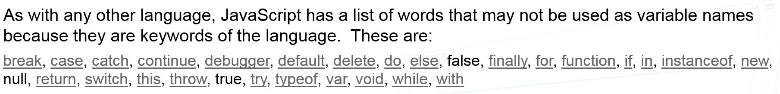
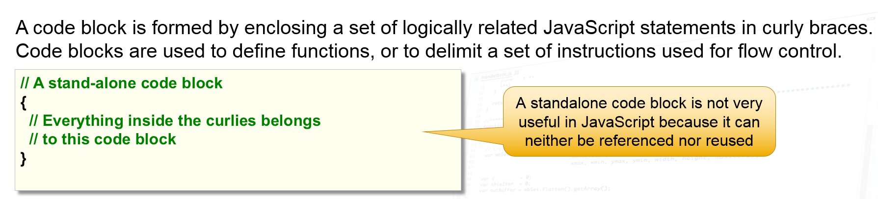
JavaScript Syntax
Source: http://www.slideshare.net/cwhealy/javascript-for-abap-programmers-1-introduction

Slide 30
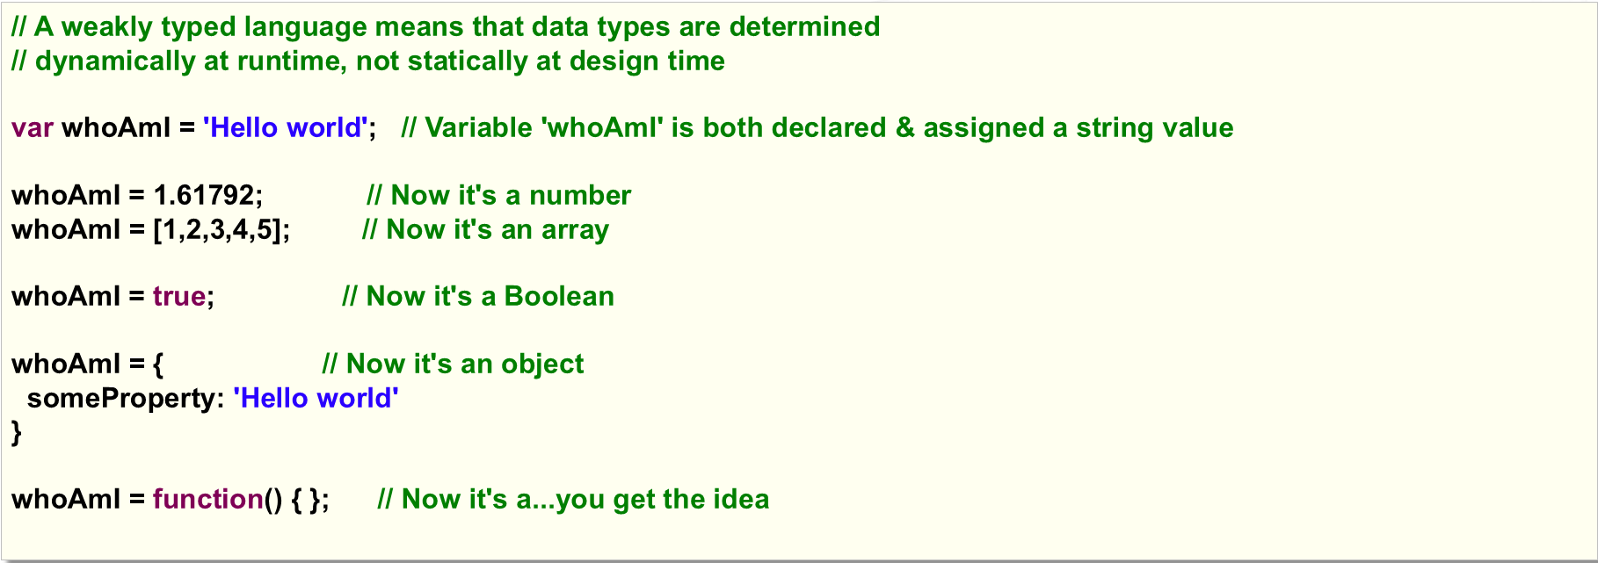
Weak Data Typing
There is no concept of variables that should hold a specific type, data type is determined by the value it currently holds.
Source: http://www.slideshare.net/cwhealy/javascript-for-abap-programmers-1-introduction

Slide 31
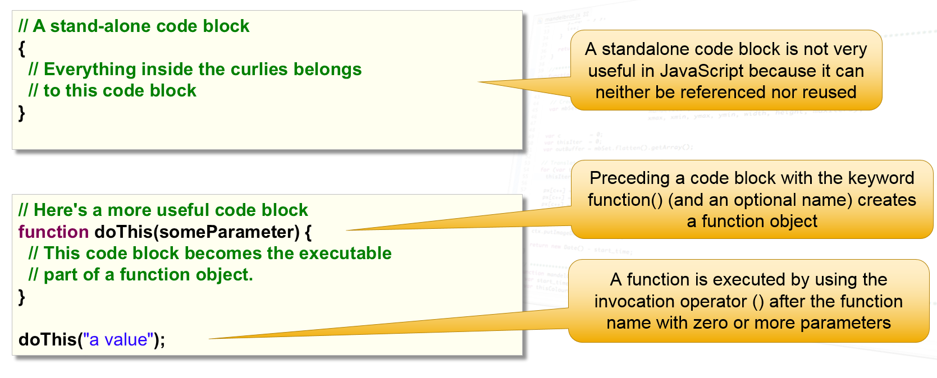
JavaScript Coding Blocks
Curly Brackets are used to define them
Source: http://www.slideshare.net/cwhealy/javascript-for-abap-programmers-1-introduction

Slide 32
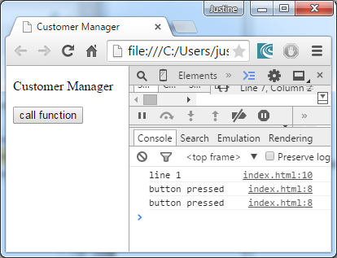
Functions
<script type=‘text/javascript’>
</script>
A function is defined by keyword function
function button(){
};
Console.log(‘button pressed’);
This is the function name
These lines will be executed when the function is called
Console.log(‘line 1’);
This line is executed after the script is loaded
<body onload=‘button()’>
</body>
The button function is called when the body is loaded, thus right after the header where the above script is loaded
<button type=‘button’ onclick=’button()’>
Call function
</button>
A button is created, when clicked,
The button function will be executed again

Slide 33
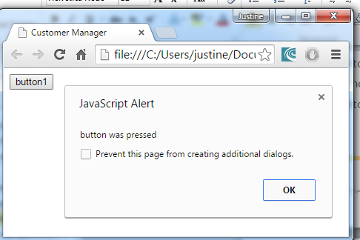
Tutorial 1 – Create your first web application
The code and instructions on your first application is contained within SAPUI5_Tutorials.doc
Tutorial 1 will cover the following:
Create the base files of an HTML file.
Integrate an external javascript file into the file.
Handle an event by calling an event-handling function.
The result of this first example will look like this:

Slide 34
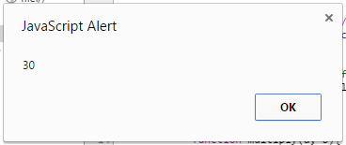
Transfer variables into and out of a function
Create a function that multiply two variables and return the result:
The function:
function multiply(a, b){
var y =a * b;
return y;
};
A and b is the two variables,
Y is a new variable that is created to hold the answer;
The value returned by the function
If the above function is called in the button function created in the previous example:
Function button(){
var num = 5;
//call the multiply function
var hold_answer = multiply(6, num);
alert(hold_answer);
}
The multiply function will return the answer of 5*6, the answer will be printed out by the alert function.
The alert function can also be used for debugging, but it will be seen by the user if not removed
This is a comment and will not be executed

Slide 35
Objects
Javascript is an object-oriented language, thus each element of the web page is treated as an object.
Each object has its own properties and comprises its own methods.
Example: The predefined window object represents the entire browser window.
The properties of the window object includes properties such as the size.
The methods used by the window object is methods such as the alert method.
Creating an Object:
Using keyword new with constructor Object()
var obj1 = new Object(); OR
var obj1 {
charac1 : ‘value1’,
charac2 : ’value2’
method1 : function() {
alert(‘the vlaue is’ + this.charac1);
}
};
The abbreviated form
{key 1: value1, key2: value2
, … : .. }
Is called JSON
JavaScript Object Notation
We will refer back to this
notation later in this course
Properties
Methods
Use keyword this to acces the context object within that object

Slide 36
variables
Use typeof to determine the type of a variable, any of the following values will be returned by the typeof operator:undefined, boolean, function, number, object or string.
Create a variable:
var variable1 = ‘text’;
Variable types:
a variable types differ because it determines the space it requires as well as the way it would be handled.
Type | Syntax
String | var svar = ‘text’;
Integer | var ivar = 234;
Float | var fvar = 23.23;
object | var Obj1 = new Object();
boolean | var bvar = true;
NaN: not a number. This value is assigned to a variable if an integer operation could not be performed.
The following line uses a function that returns a boolean value to check for the NaN value:
var bool = isNaN(ivar); // bool = true is the vlue of ivar = NaN

Slide 37
Operators
Arithmetic operator | Sign | Example
Addition | + | var name = “12” + “34”; name = “1234” var num = 12 + 34; num= 35
Subtraction | - | Var num = 34-12;//=22
Multiplication | * | Var num = 2*3;//=6
Division | / | Var num = 7/3;//=2
Increment / Decrement | Equal
iNum++; | iNum = iNum+1;
iNum-- | iNum = iNum-1;
iNum += 10; | iNum = iNum +10;

Slide 38
Relational operator | Description
== | Equal to
=== | Stricly equal to
!= | Not equal to
!== | Stricly not equal to
> | Greater than
< | Less than
>= | Greater than or equal to
<= | Less than or equal to
Equal to and strictly equal to:
‘1’ == 1; //true
‘1’===1;//false
‘1’===‘1’;//true

Slide 39
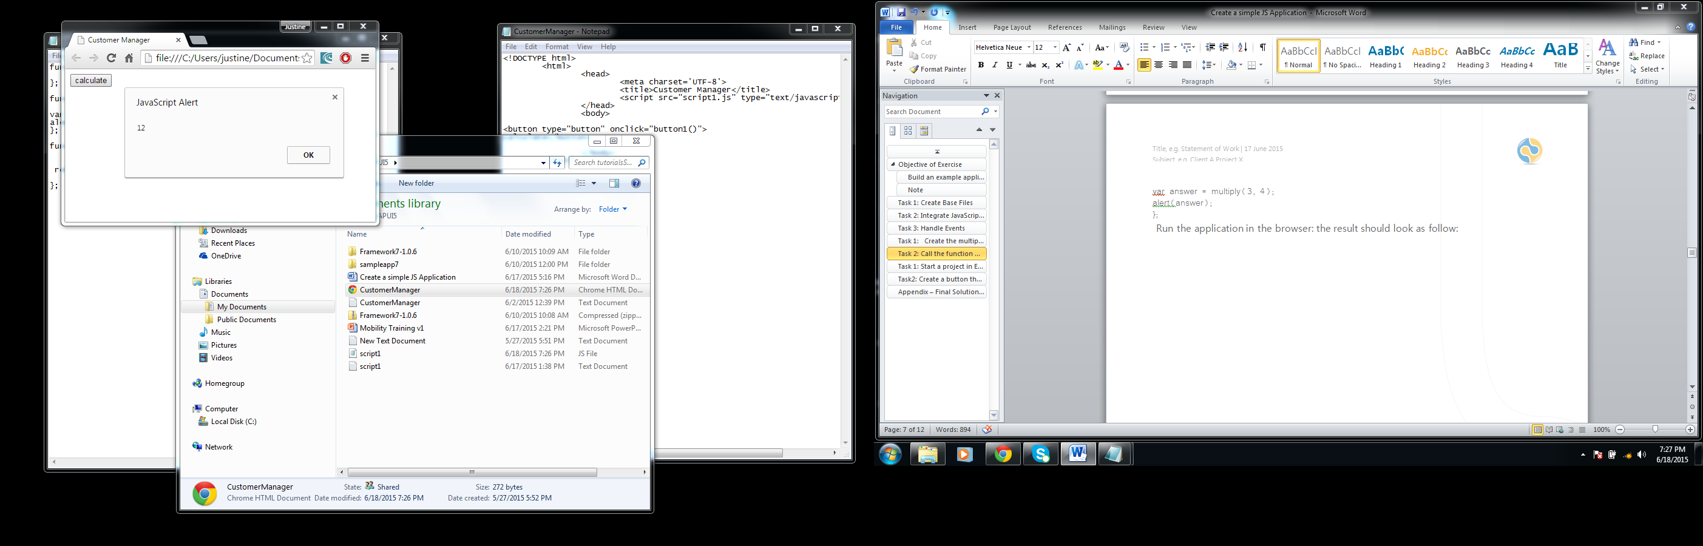
Tutorial 2: Objects, Variables and Transfering Variables
In this tutorial you will make use of variables in your java script
You will create a function that multiplies two variables and display the answer as an alert object.
Your result will look like this:

Slide 40
Logical operators
IF
The code within an if statement executes if a certain condition is true.
If(a>=10){
if(b==2 && a==10){
console.log(‘this line executes’);
}
}
If the condition a>=10 is true the code within the body will execute
This is nested if statement, this means that there are other if statements within another if statement
The conditional statement can consist of more than one condition.
This is possible due to the use of logical operators
In this example both conditions should be true
Operator | Javascript
AND | &&
OR | ||
Negation | !

Slide 41
Flow Control: Conditional IF ELSE
If(a>=10){
if(b==2 && a==10){
console.log(‘this line executes’);
}
}
else if(a==11){
console.log(‘this line executes’);
}
else{
console.log(‘default line’);
}
This condition is tested if all above conditionals are false, AND if this condition is true, its body is executed.
This line executes if all above conditionals are false
Source: http://www.slideshare.net/cwhealy/javascript-for-abap-programmers-1-introduction

Slide 42
Flow Control: Conditional SWITCH
In this conditional statement, the condition is compared to a number of values, the value that is true will lead to a codeblock to be executed. If none of the values fit, there are a default codeblock to be executed.
switch (conditional_value){
case Value1: /* code to be executed*/;
break;
case Value2:/* code to be executed*/;
break;
default:/* this is the default codeblock*/;
};

Slide 43
Flow Control: Iterations
for
The for loop executes the same block of code while a certain condition is true
The for loop statement also executes a certain line of code each time the
codeblock is executed.
for(i; i<10; i++){
//code to be executed
};
for(index_variable; condition; code executed at end){};
An iteration statement can be nested if one iteration are within another
while
A while loop executes while a certain condition is true,
a while loop can be defined in two ways:
while(condition){
//code execute if true
};
The first checks the condition before the codeblock executes.
Repeat if true
With the help of DO, the second checks the condition after the codeblock executed and determine whether the code should be executed again.
do{
//execute this code block
} while(condition)
Source: http://www.slideshare.net/cwhealy/javascript-for-abap-programmers-1-introduction

Slide 44
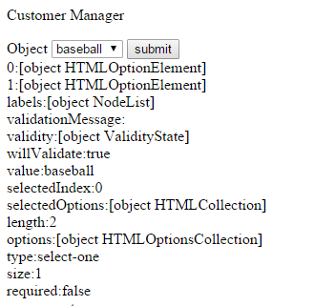
Conditional iteration: for-in loop
Example:
<script type =‘text/javascript’>
function get(){
var 0sport = document.getElementById(‘sport’);
var sOutput = ‘ ‘;
var 0content= document.getElementById(‘content’);
for(I in 0sport){
sOutput +=(i+’:’+0sport[i]+’<br>’); }
0content.innerHTML = sOutput;};
</script>
The for-in loop is useful if you want to go through all the properties of an object.
for(i in oObject1){
//line to be executed
}
<form>
<label for=‘sport’>Object</label>
<select name=‘sport’ id=‘sport’ size=‘1’>
<option value’basebal’>baseball</option>
<option value’hockey’>hockey</option>
</select>
<button type=‘button’ onclick=‘get()’>submit</button>
<br></form>
<div id=‘content’>
</div>
Source: http://www.slideshare.net/cwhealy/javascript-for-abap-programmers-1-introduction

Slide 45
Tutorial 3 : Control structures
In this tutorial you will create an array with random numbers.
The array will be passed to a function that will return the highest number in the array.
The function that will determine which number is the highest will make use of the if and for loop control structures.

Slide 46
DOM = Document Object Model
The DOM represents the web page in a tree structure.
The three basic objects of the dom are:
Window
Screen
Document
The DOM defines how each element of the web page are linked together.
The map forms an object hierarchy which will be referred to as the DOM tree.
Each Element on the HTML page becomes a node in the tree.
The HTML tags are known as elements.
The content between the tags are known as the text node.
Due to the hierarchical structure of the tree, the superordinate objects are known as parent objects, the subordinate objects as child objects, and objects of the same rank are sibling objects.
Screen: This object represents the screen.
It can be used to determine properties of the screen.(eg. Height and width)
Window: This object represents the browser window.
We have already used a method of the window, the alert method. The correct way to use the alert method would be window.alert(“message”);
Document: This object represents the web page displayed by the browser.
It can be used to access all components of this page.
Ex. Document.getElementById(“ID”); as in the example on previous slide.

Slide 47
DOM: Addressing Elements
In previous slides the elements have been addressed using the following code: document.getElementById();
When getElementsByTagname() are used, an array with all the elements of a specific type is returned.
You can address elements by using the childnodes array or one of the other properties:
Array:
This is an object that consist of a stack of objects of the same type
Create an array: var 0Arr = new Array();
Write values: 0Arr[0] = “entry1”;
0Arr[1] = “entry2”;
Use values: alert(0Arr[1]);
Property | Description
firstChild | First child node
childNodes[] | Child node [array]
lastChild | Last child node
nextSibling | Next node at same level
previousSibling | Previous node at same level
parentNode | Parent node

Slide 48
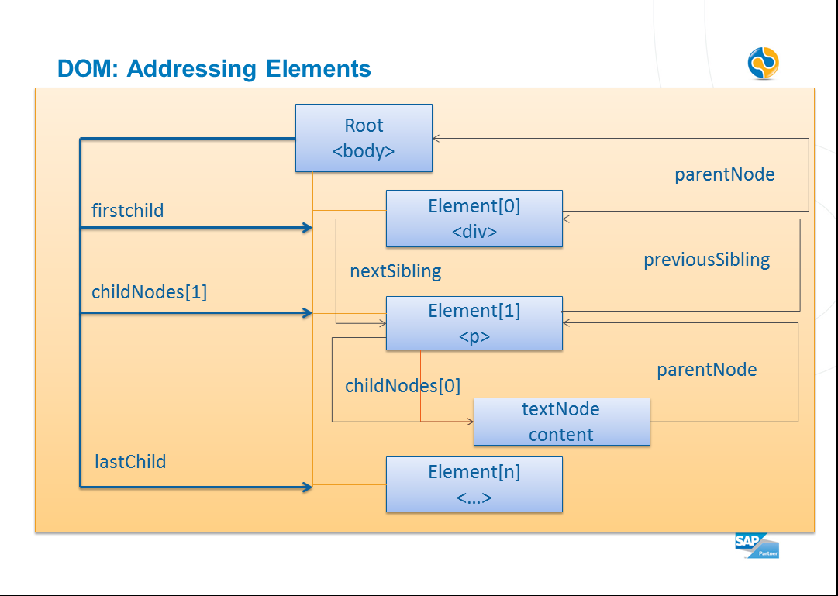

Slide 49
DOM: Manipulation
The innerHTML property can be used to add any HTML code at a particular point.
Example: in your javascript:
var Ooutput = document.getElementbyId(“output”);
Ooutput.innerHTML = “enter this line”;
In the HTML body:
<div id=“output:></div>
Return the element with id output
Add code to the webpage at that element
At this element with id ‘output’, the code “enter this line”
will be added
The entire DOM tree can be displayed by the browser.
You can browse through the tree and find properties of the elements that you can edit using javascript.
Firefox - extras>add-ons>firebug
Chrome – type window into the console, or click open the elements tab and then the properties tab.

Slide 50
DOM: Manipulation - animation
Function init(){
set(-300);
animate();}
Function animate(){
if(get()>0){ set(0);}
if(get()<0){
set(get()<0);
setTimeout(“animate()”,30); }; }
Function get(){
return parseInt(document.getElementById(‘logo’).style.left); }
Function set(n){
document.getElementById(‘logo’).style.left = n+”px”; }
For this example, the image moves slowly from the right side into the window.

Slide 51
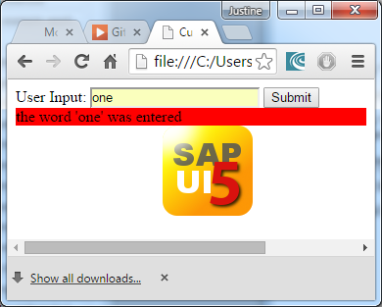
Tutorial 4: DOM
In this exercise we sill explore the following:
Receiving user input from the web page.
Using elements from the HTML page in your javascript code.
Edit text values on the web page using the DOM library.
Changing the style of an element on the web page.
Loading an image onto the web page.
Animating the image on the web page.
Your result:

Slide 52
Events
In previous slides you have already used events such as onload and onclick.
For some elements such as a hyperlink, the element respond automatically to a click event, the event for these elements do not have to be defined.
<a href=‘link.html’ onclick=‘return false;’>
Here are some of the most used events
key | event
onkeydown | When a key is pressed
onmousedown | When a mouse button is clicked
onabort | When terminated
onsubmit | When submitting the form
ondblclick | When double-clicking
onerror | In event or an error
onunload | When exiting file

Slide 53
Event - example
Var oOutput = document.getElementById(‘output’);
oOutput.addEventListener(
‘mouseover’, //this is the event
highlight, //this is the name of the function that handles the event
false //reset value to false after event is handled
};
Function highlight(){
//code to handle event
}

Slide 54
JQuery
To use the JQuery the Jquery library must be installed on your computer, it can be found at http://jquery.com/download/
jQuery is a library created to help develop a shorter code that do more. “write less, do more”
After downloading the jquery file, save it under the same directory as you webpages and rename it to jquery.js(optional)
Include the following into your code:
<script type=“text/javascript’
src = ‘jquery.js’
</script>
The JQuery library contains the following:
Element selection
DOM functions
Animations and effects, plus interface elements with jQuery UI
AJAX functions

Slide 55
Selectors
The basic construct for accessing the functions of the integrated Jquery library is $()
The browser loads the page line by line, thus a function maay be executed before the page has been fully loaded, thus it is important to implent your functions within the ready function. This ensures that the page is loaded before the function is executed.
<script type=“text/javascript’>
src = ‘jquery.js’
</script>
<script type=‘text/javascript’>
$(document).ready(function(){
//implementation });
</script>
You can address the HTML elements in Jquery by selector, similar to CSS selectors:
CSS | jQuery
Element[…} | $(‘element’)
#id | $(‘#id’)
.class | $(‘.class’)

Slide 56
jQuery: Selectors
The $(‘p[id]’) selector means to select all p elements with an ID.
Example:
<script type=‘text/javascript’>
$(document).ready(function(){
$(‘#para’).animate({
width : 70%,
opacity: 0.4. ///rest of code
}, 1500); });
</script>
<body>
<p id =‘para’>Paragraph</p>
</body>
This example animates the phrase ‘Paragraph’ to increase in size until it occupies 70% of the space.
If there were two elements with id = para, the animation would be applied to both the elements.
Most jQuery functions return a jQuery object again. As a result, the objects can be chaned together using notation: $().method1().method2(); example:
$(document).ready(function(){$(‘p’).animate({/*the parameters*/;}, 1500).fadeOut(1000).fadeIn(100); });
After the page loaded, the animation starts, then the elements fade, then it fades back in.. This is three actions in a chain

Slide 57
jQuery: Events
To bind a function to an event as in previous slides, the following notation is used:
$().mouseover(handler);
This is an over view of the most important functions:
An example on how to use them are provided on the next slide
key | Description
.bind | Bind handler to event
.on | Bind handler to event
.blur | Event when element loses focus
.click | Click with mouse button
.dbclick | Double click mouse button
.keypress | A keyboard key is pressed
.change | A form field is changed

Slide 58
jQuery: Event - example
In header:
<style>
.gray { background-color : gray }
.l_gray { background-color : lightgray }
.border { width : 90px;
height : 90px;
border : 5px solid black }
</style>
<script type=‘text/javascript’>
$(document).ready(function(){
$(‘#box1’).mouseover(function(){
$(this).removeClass(‘gray’);
$(this).addClass(‘l_gray”);
});
$(‘#box1’).mouseout(function(){ /*same as above, just switch colors*/;});
});
</script>
The color of the background of a <div> with
Id=box1, changes when you move the mouse over it.

Slide 59
jQuery: DOM manipulation
Where we previously used:
Function display(){
Var oName = document.getElementById(‘day’);
Var oOutput = document.getElementById(‘output’);
oOutput.style.color=“red”;
oOutput.style.backgroundColor=“yellow”;
oOutput.innerHTML=“This line..”;
}
<button type=‘button’ onclick=‘display()’>
submit </button>
<div id=‘output’></div>
We now use with Jquery:
$(document).ready(function(){
$(‘#button’).click(function(){
$(’output’).text(“This line ..”).css(
{ color : ‘red’,
backgroundColor : ‘yellow’
});
};
});
<button type=‘button’ id=‘button’>
submit </button>
<div id=‘output’></div>

Slide 60
jQuery: DOM manipulation
If you want to add another DOM node the following methods are provided by jQuery:
key | Description
.after() | Appends content after element
.append() or .appendTo() | Append content at end of element
.insertAfter() | Inserts content in the element
.prepend() .prepentTo() | Prepend content to beginning of element
.insertBefore() | Insert content before element
.remove() | Removes the element
.wrap: | Wraps element with defined HTML structure
.addClass: | Adds element to specified class
.removeClass: | Removes element from specified class
.css: | Sets the CSS property
Example: $(‘p’).after(‘<div id=‘output></div>’); // appends content after <p>

Slide 61
jQuery: AJAX – Asynchronous JavaScript and XML
Up until now, all the examples were loaded from the local hard disk and diplayed in the browser.
If you want to implement some dynamics to the page, you would want an option to reload parts of the page.
To reload parts of the page you want to send requests to the web server without reloading the entire page.
This is where AJAX comes in.
AJAX allows asynchronous data transfer between the browser and the server backend.
This backend server in our case would be the SAP NetWeaver Application server.
The AJAX takes place in four steps
Create AJAX object
Define server connection
Query data from the server
Receive response from the server

Slide 62
jQuery: AJAX
STEP 1 – create an AJAX object
The object should undertake the http request and receive response from the server:
var oRequest = new XMLHttpRequest();
STEP 2 – Establish server connection
Use the open method of the XMLHttpRequest object:
oRequest.open(
http-Method (GET, POST, PUT, DELETE)
URL (URL from backend)
Request-Method (asynchronous true or false, optional)
User(user name, optional)
Password(password, optional)
);
To test if a request has been completed: use the attribute readyState, it returns the following values:
Only choose false if response for further processing is necessary, eg. In the case of forms.
Thus always choose true, thus the system does not wait for a response from the server/
readyState | Explanation
0 | Not initialized
1 | Initialized
2 | Contacted
3 | Data stream from backend is loaded
4 | Completed

Slide 63
jQuery: AJAX
STEP 3 – sending data to the server:
Use the send() method to send data to the server:
oRequest.send();
POST you do not have to transfer any further arguments.
GET expects the key value pair as transfer paramaters, key1=value1 & key2=value2
STEP 4 – Processing data
Two attributes are crucial when processing the received data:
HTTP Status code –returned by each server upon an HTTP request
1XX – Information
2XX – Successful request
3XX – Redirecting
4XX – Client-Side error (404 would mean ‘resource not found’)
5XX – Server-side Error
Response –depending on data format, the response is located in another attribute
Data Type | Attribute
Text Data | responseText
HTML | responseText
javaScript | responseText
JSON | responseText
JSONP(with padding) | responseText
XML | responseXML

Slide 64
jQuery: AJAX
The AJAX() object:
You can execute an AJAX call directly via $.get()
Example direct call:
$AJAX({
url: ”http://<server>:<port>/path/”
success: function(result){/*imlementation*/;}
});
$.get(“http://<server>:<port>/path/”, functio(result){/*implementation*/});

Slide 65
JavaScript object notation
Working with data

Slide 66
JSON
JSON: JavaScript Object Notation.
JSON is a syntax for storing and exchanging data.
{“customers":[ {"firstName":"John", "lastName":"Doe"}, {"firstName":"Anna", "lastName":"Smith"}, {"firstName":"Peter", "lastName":"Jones"} ]}
Notes:
JSON is a lightweight data-interchange format
JSON is language independent *
JSON is "self-describing" and easy to understand
The JSON format is syntactically identical to the code for creating JavaScript objects.
Because of this similarity, instead of using a parser (like XML does), a JavaScript program can use standard JavaScript functions to convert JSON data into native JavaScript objects.

Slide 67
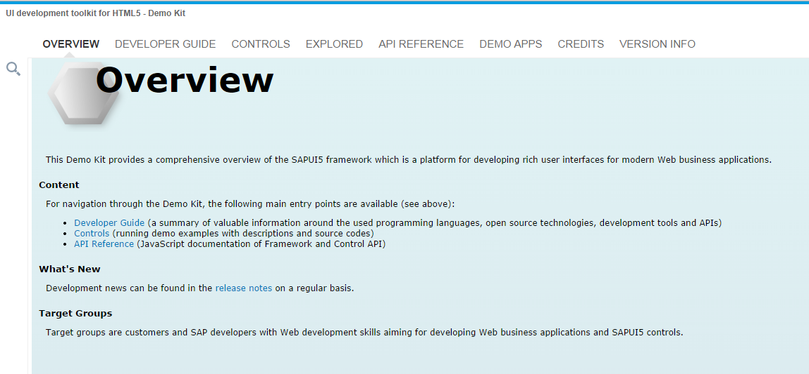
SAP UI5
The UI development toolkit for HTML5 (SAPUI5) is a user interface technology that is used to build and adapt client applications.
The library is a UI development environment that can be used to deliver responsive applications using the Model View Controller architecture pattern.
It is a set of UI controls and patterns that can be used to develop applications. A lot of the binding and heavy lifting has already been developed by SAP.
https://sapui5.netweaver.ondemand.com/sdk/
https://tools.hana.ondemand.com/

Slide 68
SAP UI5 development
SAPUI5 is based on HTML5, CSS, AJAX and widely used jQuery library – the framework can be used to develop fast and flexible applications that can run on most devices.
Typically you would build a SAP UI5 application using Eclipse as the development environment.
The application Server:
When a web page is called, the requested page is retrieved by a server, and then rendered and displayed by your browser.
In a SAP context, this server would be the SAP NetWeaver Application Server.
Web Browser
Application Server
Database
HTTP Request
Data Acquisition
HTTP Response
Selection result

Slide 69
Tutorial 5: Your first SAP mobile application
Before starting this tutorial, first refer to the Setup_Eclipse document in order to setup the development environment for the rest of the tutorials in this course.
In this Tutorial you will create an application using SAPUI5.
The application will show a web page with a button, if the button is clicked, your application will display an alert.

Slide 70
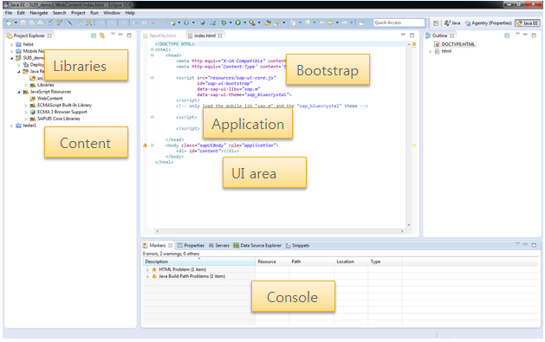
Eclipse workspace layout

Slide 71

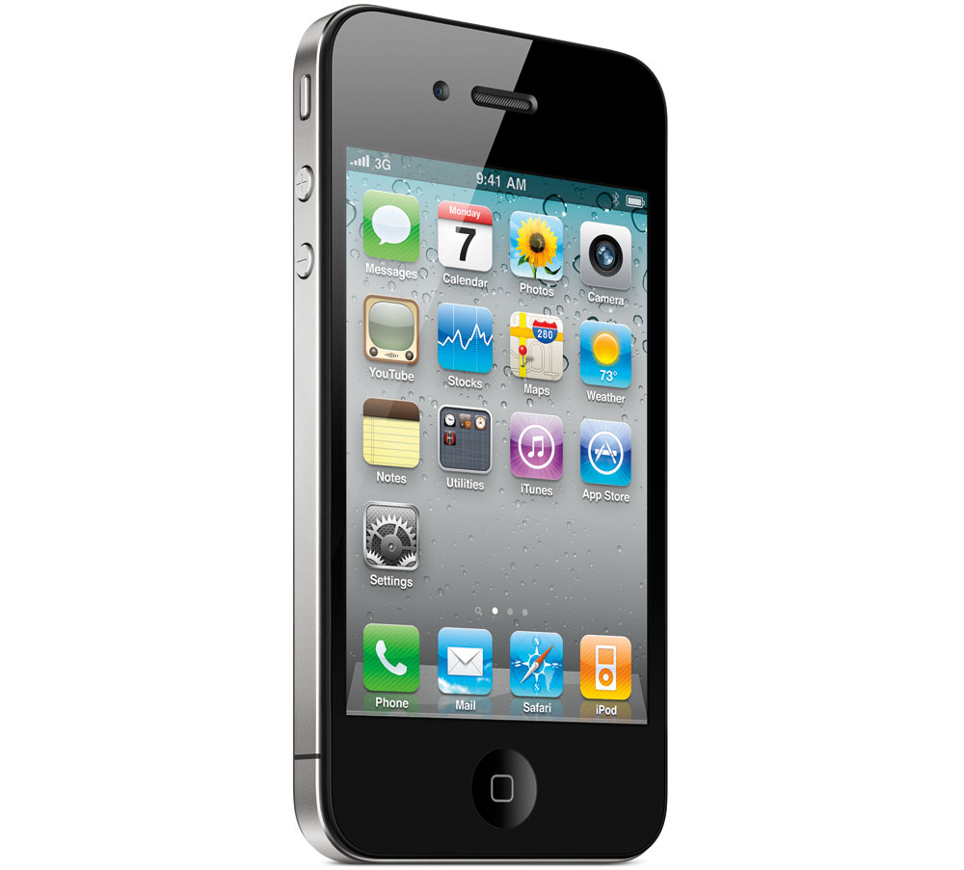
Model View Controller architecture Pattern
The Model View Controller Architecture Pattern structure the software development in the three units: Model, View and Controller.
Model
Controller 1
This separation enables, for example,
two devices to use the same model:
The view is implemented once for the
desktop and once for the mobile device.
Controller 2
View 1
View 2

Slide 72
Model View Controller Architecture
Model
The model represents the data model layer.
The application data is provided by the model.
The model are sometimes referred to as the publisher
View
The view is the display on the device
The view receives user actions, but does not process them.
The user actions are forwarded to the controller.
Controller
The controller manages multiple views. The controller receives user actions and analyzes them.
If a data change occurs, the controller performs the communication with the model.

Slide 73
Model View Controller: Interaction in Web Development
Controller
Update
Update
Notification
User Interaction
Model
(JSON, XML, Odata)
View
SAP Libraries

Slide 74
SAPUI5: Resources
On the previous slide various libraries are used in the Bootstrap area.
Data-sap-ui-libs etc.
When we discussed JQuery, we were actually discussing a series of libraries.
SAPUI5 is divided into several UI and JavaScript libraries.
Sap.ui.core, sap.ui.model, etc,
a brief description of all the libraries can be found in this table:
Resource | Description
Sap-ui-core.js | Default resource: contains JQuery.
Sap-ui-core-lean.js | Similar to above, only a few components are loaded immediately
Sap-ui-core-all.js | Contains all SAPUI5 library resources
Sap/ui/core/library-preload.js | Similar to above, but individual components are parsed as required
Sap-ui5.js | All javascript modules
Sap-ui-custom*.js | Reserved namespace for customer development

Slide 75
Tutorial 6: application in MVC form
In this application you will create an application with three different files that work together:
The index or HTML page
This page contains all the elements of the application, in this example your HTML page will contain one application that consist of one view or page.
The View
The view is a javascript file that is called from the HTML file, the view creates and returns the contents of a view of page to be displayed.
The Controller
The controller serves as an event handler this is where all the event handling functions is defined, the event handling functions is refered to as oController.functionname.

Slide 76
The Index page of an SAP application:
Bootstrap
Application
UI Area

Slide 77
SAPUI5: Theming
In the bootstrap area, the following line appear: data-sap-ui-theme="sap_bluecrystal“
This is one of the standard themes provided by sap.
Another example of a sap theme is sap_mvi which is only available for mobile applications.
To change the theme of a page with the following code:
sap.ui.getCore().applyTheme("sap_goldreflection");

Slide 78
The Application
The first line of the application defines where the files of your application is contained under the WebContent folder, in this case it is contained in the sui5_demo file, the files created in you workspace would look like this:
The contents of WebContent:
The second line is where you create your application, sap.m.App.()
Within you application definition you can define some settings.
In this case the setting of the initial page was set(the id of the page is used as the parameter).
Note that the settings are in JSON format.

Slide 79
Application: Page or View
After the application is defined, you can create a page:
Sap.ui.view allows you to create a view or page.
The parameters to be set in the definition of a new page:
The page id, the id allows the page to be referenced in the application.
The view name, this name can be found at the top of your controller or view file, it is usually the applicationname.givenpagename.
The type of page usually sap.ui.core.mvc.ViewType.JS
The .addPage method allows you to add a page to the application from outside the application definition.
The .placeAt(); method specifies where the application should be placed in the web page.

Slide 80
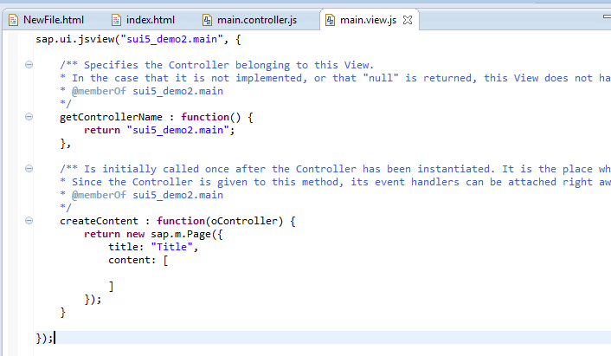
The View (page)

Slide 81
The View(page): Create content
The function CreateContent in the view file returns a page to the html file that would be displayed.
The parameters of the Page can be set within the definition of the page, this can include the title, scrolling options and the content of the page.
To add an element to the page, the element can be defined in the CreateContent function and then positioned within the content of the page.
var aButton = new sap.m.Button();
aButton.setText("click this button");
var page1 = new sap.m.Page({
title: "Categories",
enableScrolling: true,
content: [
aButton,
]
});
return page1;

Slide 82
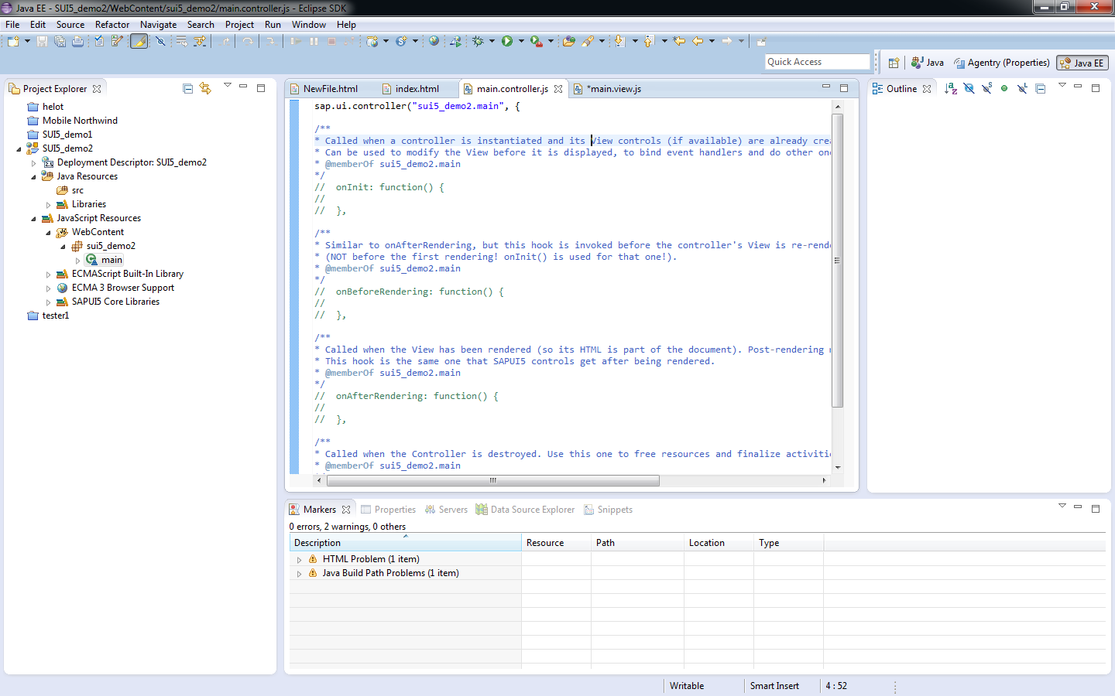
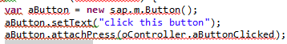
Controller: event handling
Event handlers can be defined within the controller:
The event can be called using the following syntax:

Slide 83
SAPUI5: Data binding Models
SAP provide several data binding methods:
JSON
XML
Resource
Odata
The data binding principle always stays the same:
Data definition
This can take place locally or from an SAP system
Create an instance of the data binding model
Bind a model to the UI control.

Slide 84
SAPUI5: Data Binding: ODATA Model
Create an instance of the Odata Model:
Var OModel = new sap.ui.model.odata.ODataModel(<URL>);
Binding Options:
After the model has been created, the model can be assigned to the core element or specific element with the “setMethod” method.
If two models are bound, the relevant model for a control will be the element closest to the root.
Examples;
Model at Core:
Sap.ui.getCore().setModel(oModel);
Model at UI level:
Var oMainArea = sap.ui.getCore().getUIArea(“main”);
oMainArea.setModel(oModel);
Model on a control
Var oTable = sap.ui.getCore().byId(“table”);
oTable.setModel(oModel);

Slide 85
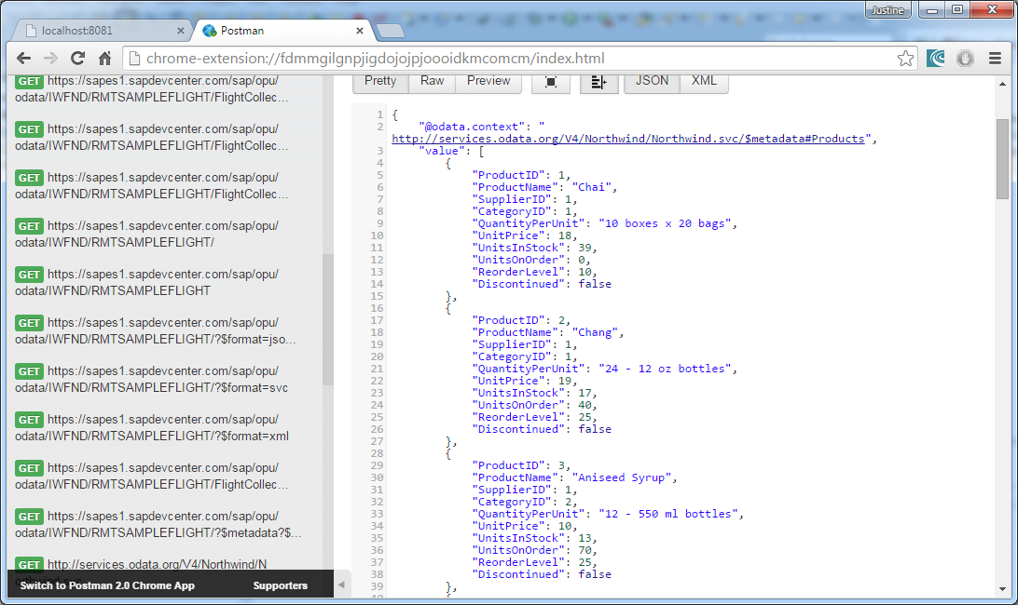
Tutorial 7: Task 1 : Binding data
For this tutorial we will create a connection to the northwind database using aggregation.
The data we will be using is in JSON format

Slide 86
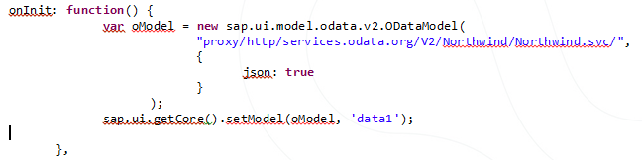
Tutorial 7: Task 2 : Binding data
When the page is created we want the connection and model to be set immediately, thus create your model within the onInit event in the controller. The onInit event is the first lines that will be executed when the page is executed.
Since we are working with sap.m, the new way of defining the url is to add ‘proxy/http/’ as a prefix to the web address
Set the model with an id:

Slide 87
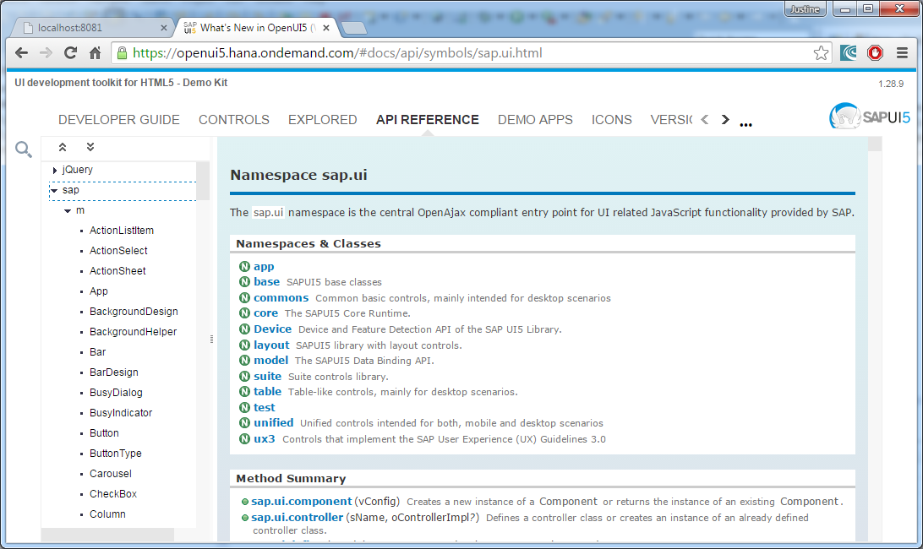
Tutorial 7: Task 3: using the sap library
The sap library can be found at the following web adress: https://openui5.hana.ondemand.com, under the API Reference tab:

Slide 88
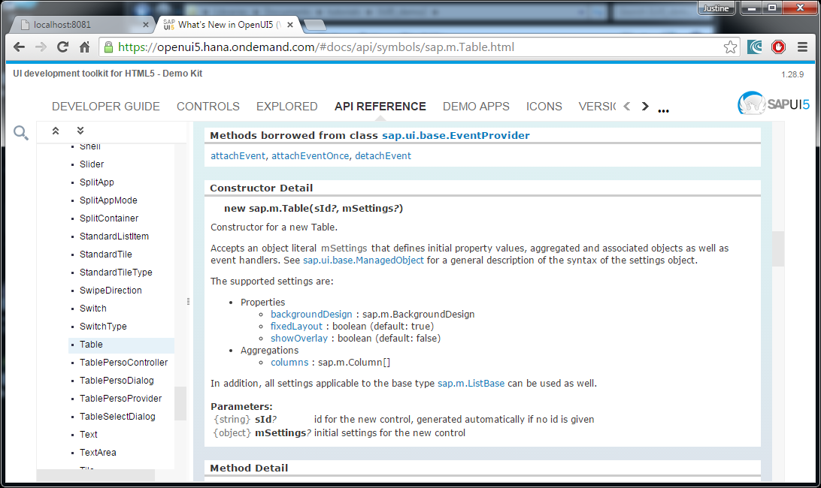
Tutorial 7: Task 3: using the sap library
On the lefthandside you will find an expandable menu, expand sap>m. Here you will find a lift of API’s that you can use in your project. For this project, you want to create a table, thus go to the table API:

Slide 89
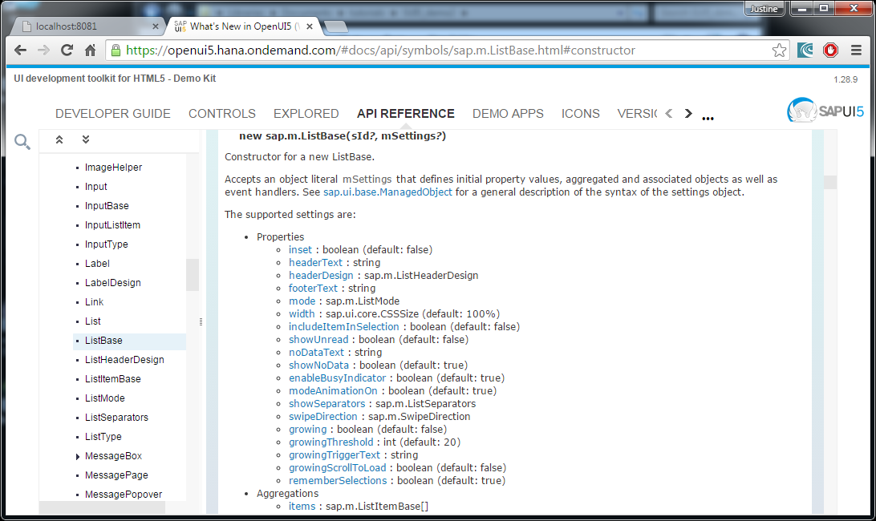
Tutorial 7: Task 3: using the sap library
Create the table: oTable = new sap.m.Table({});
The properties of the table can be set as well as aggregations, use the list of properties as a guide to how to set different properties of your table.

Slide 90
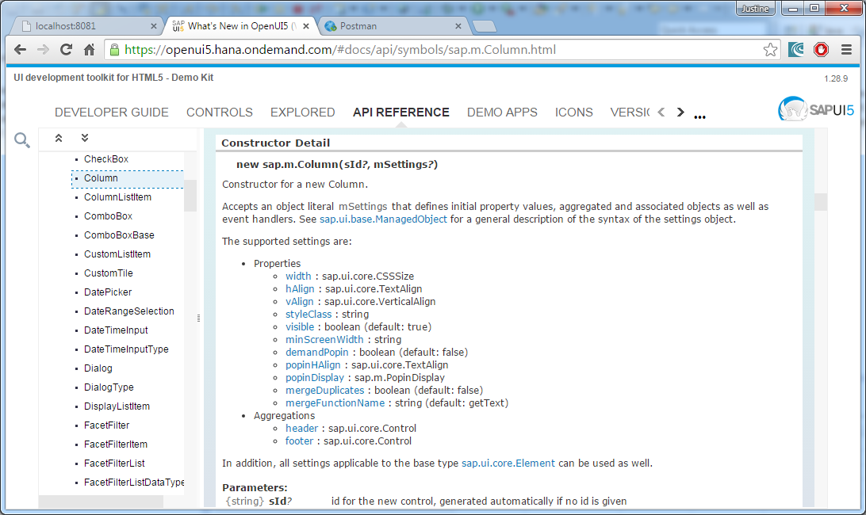
Tutorial 7: Task 4: Add columns
The Column API should be a guide to how to create new columns for the table:
oTable = new sap.m.Table({
headerText: "My first table",
columns: [ new sap.m.Column( {header: new sap.m.Label({text: "ID"})}),]
})

Slide 91
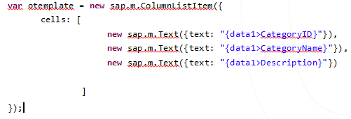
Tutorial 7: Task 5: Template
The data model that we want to connect to the table template has an id ‘data1’ thus we must point the text to the column we want in that database.

Slide 92
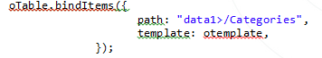
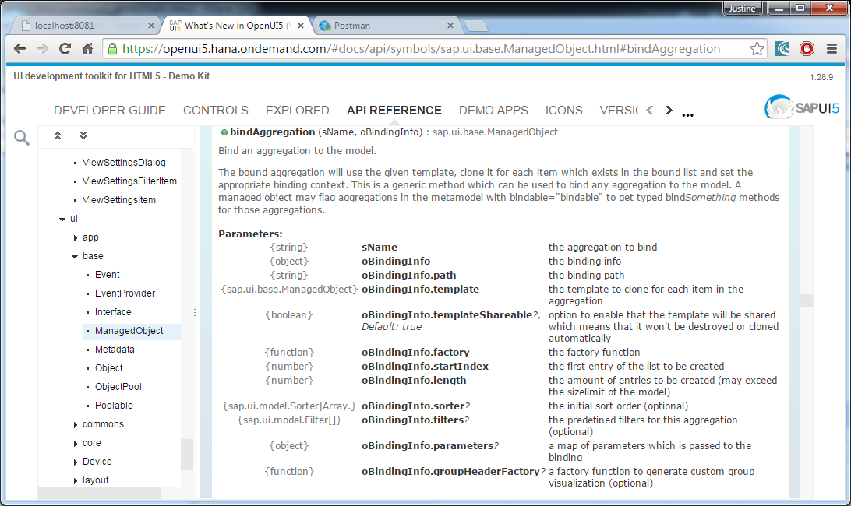
Tutorial 7: Task 6: bindItems
We now want to bind the items in the table to the data model ‘data1’ using aggregation. The template will be a guide to the binding form.
The northwind database has more than one table, thus a path to the specific table should be created:

Slide 93
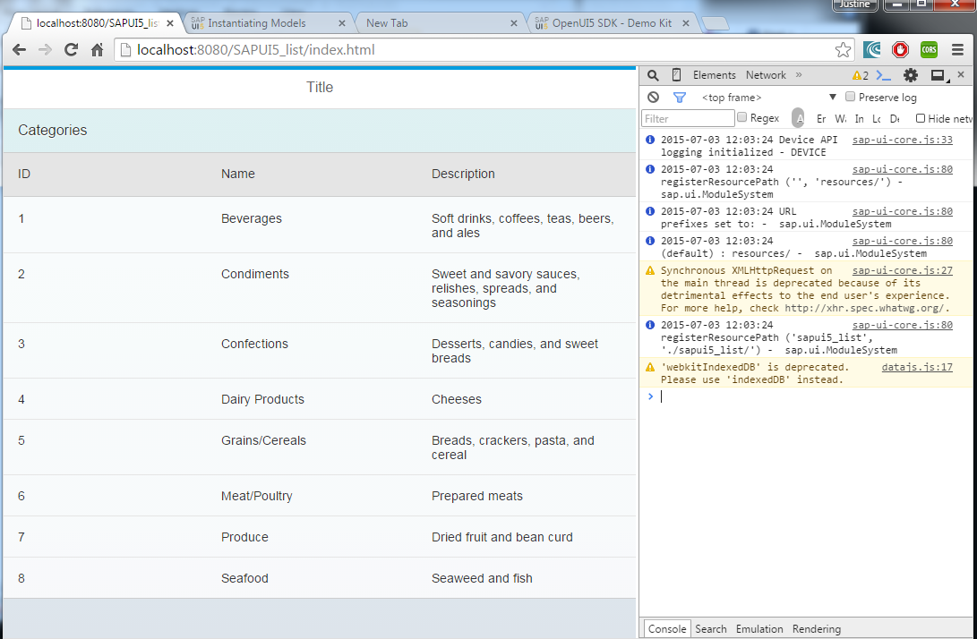
Tutorial 7: result

Slide 94
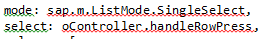
SAPUI5: Event handling
The controller file will be containing all the event handling functions, eg. Function rowselected(){},
When a function from the control file is called, the following syntax is used: oController.rowselected;
Some elements such as the table has a list of events that can be used listed in the API reference documentation.
For a table the selection mode can be set as well as the function to be executed when a row is selected:
For other elements, an action event handler can be added using methods such as .attachPress(oController.rowselected);

Slide 95
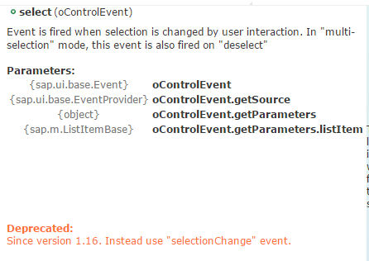
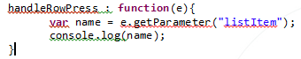
Tutorial 8: Interacting with the table
The first two tasks of the tutorial will cover event handling.
The event of selecting a row will call a function handleRowPress in the controller file.
Task 3: we want to get the parameter of the row selected: we used the event ‘select’ to call this event the following parameters are passed with the event, click on the event link to get this:
Lets inspect this element

Slide 96
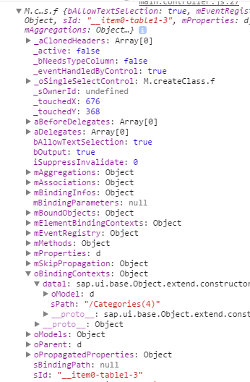
Tutorial 8: task 3: Inspection method (IMPORTANT)
The element is sent to the console window using the console.log method. This method is mainly for debugging purposes:
When expanding the element in the console window we find:
This expansion shows us how to find properties of this
element.
To find the path to the selected element we can determine the
path from this image: element>oBindingContexts>data1>sPath

Slide 97
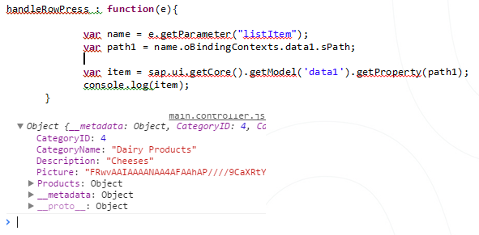
Tutorial 8: task 3: Getting the item from the path
Now that we have the path to the item, we can lookup the item in the data model data1:

Slide 98
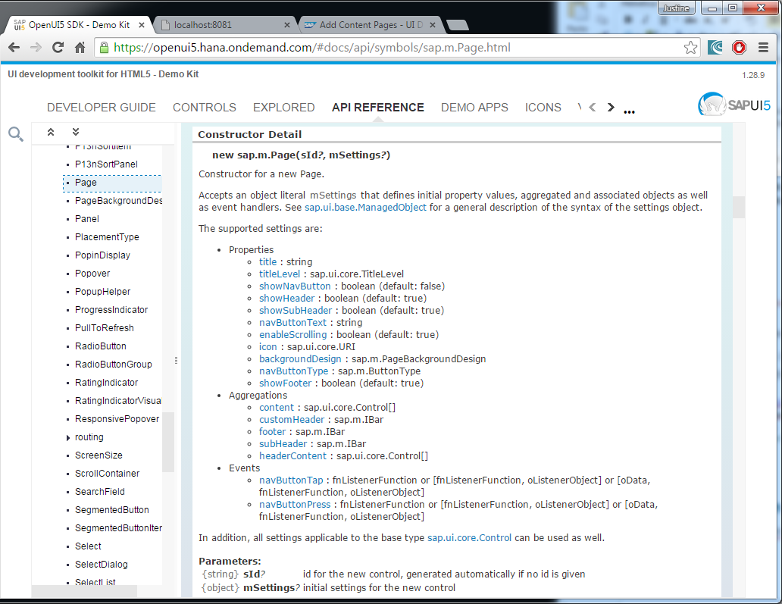
Tutorial 9: Add a page, navigation
Follow the steps in tutorial 9 task 1 to add a new view to the application.
This is the API reference to the Page constructor:

Slide 99
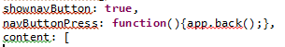
Tutorial 9: Task 2: navigation
One of the events of a page is navButtonpress.
A method that can be used is the .back() method, this method is listed under the methods that can be used by the App element. The back() method will return the application to the previous page.
Another method that can be used by the App element is the .to(‘page_id’ ) method, this will direct the application to the page with the id ‘page_id’.

Slide 100
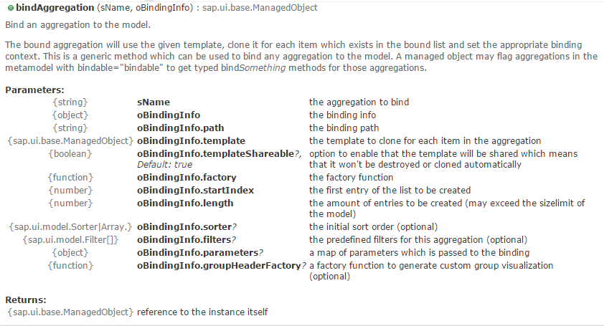
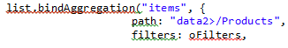
Tutorial 10: filters
In the API reference of bindItems, there are a property that can be set: filters.

Slide 101
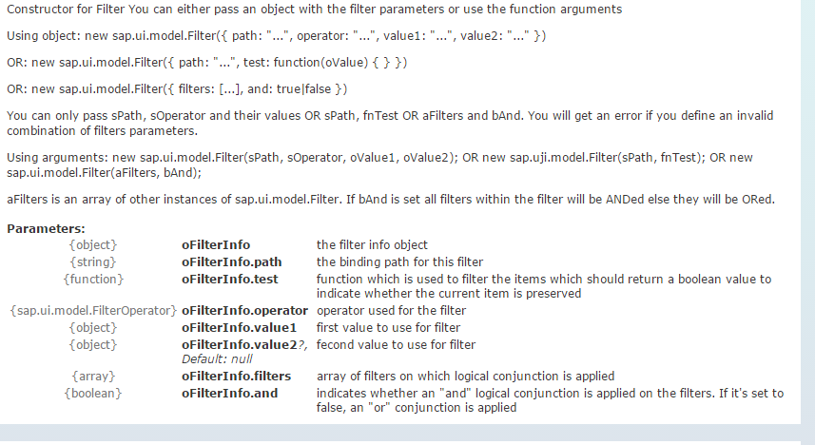
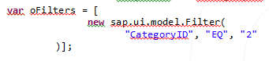
Tutorial 10: filters
The filter can be created using its API reference;

Slide 102
Tutorial 10: filters
Currently the filter can not take a data bound object as a parameter, but the sap.m developing team are working on it so we are looking forward to using the filter with data bound parameters:
var oFilters = [
new sap.ui.model.Filter(
"CategoryID", "EQ", “{selected>CategoryID}"
)];

Slide 103
API References
By now you should be quite familiar with the use of the API refernces in the Developer toolkit, you do not have to learn every API, but you should know how to use it, here is a quick summary:
Use the constructor to create a new element.
The listed properties, events and aggregations can be set within the constructor.
Is another list of properties are indicated, eg listbase, there will be a link under the constructor reference.
If for example you want to set the event ‘select’ click on that event to see what parameters is passed with the event.
There are a list of methods to be used with each element
Click on the method you want to use to get details on this method

Slide 104
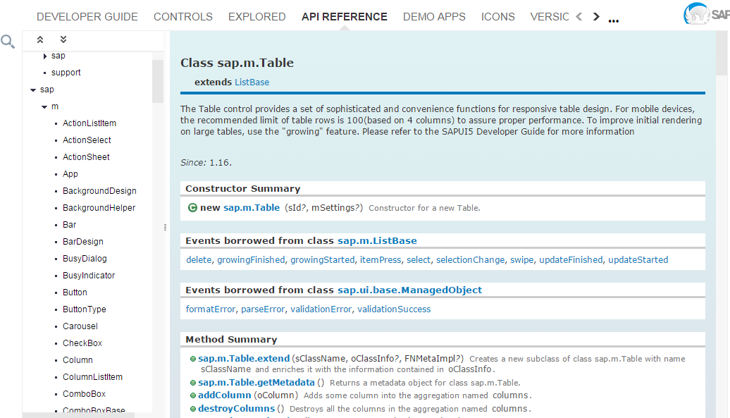
API references
List of elements
Constructor
Methods to be used

Slide 105

API References: Methods
More methods that can be used.
Lets use method . attachItemPress,
eg
var tab = new sap.m.table();
tab.attachItempress();

Slide 106

API Reference: Methods
Parameters that the method can take
Description
The value to be returned by the method

Slide 107

API Reference: Constructor Detail
The settings that can be set within the setting parameter: eg
new sap.m.Table(“id”,{
showOverlay: true,
columns: [….]
});
Note the setting are in JSON format
When clicking on the additional base type, there are more settings and methods that can be used by the Table
The Parameters that can be set.
The Constructor syntax will look like this:
new sap.m.Table(“id”,{settings});

Slide 108

API reference: Properties
When clicked on a property, the method and details that can be used for this property is shown:
In this case you can either just set the Overlay to true or false, or use the method given by clicking on the link:

Slide 109

API References: Aggregations
You can either create a column using the sap.m.Column[] constructor, see details when clicking on the grey link, or get columns by clicking on the blue columns link which gie us the following method that can be used:
There are other options for editing the columns also listed, like the .addColumn or .destroyColumns methods, these are all listed under the methods.
The trick to it all is to read the descriptions and following the links given, the API Reference documentation is very informative.
Remember to go back and make sure of the library you are using and new updates, we want to use the sap.m library and not the sap.commons library.

Slide 110

Tutorial 11: SplitView
Using the API references, create a Split view app.
The following APIs will be explored: list, App.

Slide 111
Tutorial 11: Task 7: Creating a data model.
If you want to preserve a certain object for later use in another view or controller, the object can be preserved in a model. In this tutorial the object to be saved is in JSON format thus create a JSON model with an id that you can use to reference later:
If you want to use the object at a later stage, you can use the model’s id and just point to the property you are using:

Slide 112
Mock Data Server
The information on a Mock Server can be found at: https://openui5.hana.ondemand.com/#docs/guide/69d3cbd4150c4ffb884e788f7f60fd93.html
The Mock Server is used to simulate Odata backend calls.
The Mock Server will mock the framework for HTTP and HTTPS, this is used to simplify integration testing and decoupling development teams by allowing development against a service that is not complete or unstable.
In openUI5:
Odata backend calls will be mimiced.
No network connectivity to a host is needed since it is simulating the Odata provider and is completely clientbased.
How it works:
The HTTP calls mde to the server will be intercepted.
A fake output will be provided to the client.
This will look exactly like the data model we have been using this far and will feel exactly like a real server. We do not have to change the current model we are using.

Slide 113

Mock Server Data
This mock server will provide mock data as well as mock data.
The features supported by the Mock server are provided at: https://openui5.hana.ondemand.com/#docs/guide/3459c372aaaa4c31ab87bb0e174adcc3.html
Remember that the Mock server only support JSON format for representing the resources it exposes.(collections, entries and links)

Slide 114

Tutorial 12: Mock Sever in SAPUI5
The following is a link to the API reference of the mock server: https://openui5.hana.ondemand.com/#docs/api/symbols/sap.ui.core.util.MockServer.html

Slide 115

Tutorial 12: MockServer
To use the mock server, we must include the library to the application.
jQuery.sap.require(“sap.ui.core.util.MockServer”);
The MockServer used a metadata XML file to guide the application to the data tables.
To get the metadata file, the basic Odata protocol can be used by extending the url of the webdata with /$metadata.
Example url: http://services.odata.org/v2/Northwind/Northwind.svc/$metadata

Slide 116
Tutorial 12: MockServer: MockData
The Mock data used by the mock server are stored in a JSON file in JSON format, to get a data table in JSON format the extension ?$format=json.
Use postman –RestClient and Sublime Text to Complete these tasks described in the tutorial.
The data model should point to the file that contains the mock data and metadata file
You can set the MockServer to generate false data by setting bGenerateMissingMockdata to true.
Remember to still use proxy/ as a prefix to you URL in order for the model to perform a get method when creating the model.
Using the Mock Data further on is exactly the same as using the real data, thus no further changes has to be made. Remember the mock server is only for developing and debugging purposes.

Slide 117

Tutorial 13: Create entry: Dialog
In tutorial 13 we want to create a new entry in the products table, remember the changes will only be made in the mock server and will not reflect in the actual data.
In this tutorial you will be introduced to an element called the Dialog.
We can use the createEntry method as well but for this course we will stick to the basic CRUD methods: create, remove, update

Slide 118
Tutorial 13: Add Entry:Dialog
The dialog is a temporary construct and will be created every time it is called along with all the elements it contains.
Because of the reason mentioned above the application will throw an error if the dialog is called twice, this is because the dialog and the elements it contains are already created and the new dialog will seem like a duplicate. Thus the Dialog and all the elements should be completely destroyed after it has been used.
sap.ui.getCore().byId("CreateE").destroy();
Create new entry
Create Dialog
sap.m.Dialog(‘id’,{})
Open
User edits contents of dialog
Destroy Element
Cancel
Close Dialog
Create entry in model
Get content of Dialog
Submit

Slide 119


Tutorial 13: Add Entry: Input
Again we are emphasizing the importance of familiarizing yourself with the Demokit and how to use it.
It is very important that you carefully choose the UNIQUE ids of the input elements.

Slide 120

Tutorial 13: Add Entry: Submit
See how the ids chosen when creating the Input fields are very important since you will be using them again and the eclipse program will not correct them or recognize the error.
For creating a new entry you should only provide the path to the table as well as the element to be added:
sap.ui.getCore().getModel('data1').create('/Products', newEntry);
To see the changes, the data model should be refreshed using .refresh().

Slide 121

Tutorial 14: Delete record
A lot of the code that you have used for creating a new entry can be copied into the delete function, this way you can avoid spelling ids wrong.
To retrieve the item being selected, the inspection method can be used.
var name = sap.ui.getCore().byId("Productslist").getSelectedItem();
var path1 = name.oBindingContexts.data1.sPath;
var item = sap.ui.getCore().getModel('data1').getProperty(path1);
The inspection method requires that you print the element out to the console and expanding the structure to get the path to the specific property
To delete a record you should provide the path to the item. Eg : /Products(8)
The remove function will be used.
Remember to destroy the deletedialog

Slide 122


Tutorial 15: Update
In this tutorial we are again using the dialog element.
The contents of creating a new entry dialog can be copied but with a few minor changes.
The values of the selected item should be added to the input fields.
The value can be retrieved by the inspection method.
Remember to cross-reference the ids you use:

Slide 123
Tutorial 15:Update
The code used to submit new data to the model can be used to update the changes aswell, the only diference is:
The update function instead of create function is used.
The path to the selected item is required as well as the new data.
Remember to also destroy the dialog and its elements by id.

Slide 124

XML View
Before we write the application in XML we will first familiarize with XML by incorporating it into a MVC format application.
The view of an MVC format application can also be created in XML instead of javascript.
The reason we are exploring XML is because even though Fiori 1 apps are written in HTML, Fiori 2 will be written in XML.
XML look very similar to HTML and are incorporated into the MVC format.

Slide 125


Tutorial 16: XML in MVC
The XML view page are included into the application in the following manner:
The main.view XML page will look like this:
The “view” contains a “Page” that has the contents in the “content” division.
XML comments: <!-- -->

Slide 126

XML View: Use the API Reference Documentation
When you look at the contructor in the API reference documentation of the Page all the Attributes, Aggregations, Associations and Events are shown, you should be familiar with the use of this documentation.

Slide 127

Tutorial 16: XML adding elements
The prefix namespaces:
The prefix “core” is used on the root element itself, the “core:View”
The namespace sap.m and sap.ui.core ince most of the controls are from these libraries.
Controls:
Adding a control is as simple as opening and closing an element pair: <Page>…</Page>
Similar to the elements in javascript, the control Page has attribute: Title amongst others Properties are declared using XML attributes(title=“title”).
These are added within the control.

Slide 128

Tutorial 16: XML aggregations
An aggregation can be seen as a child control of the current control.
The child controls inherits from the parent control.
thus in this example, the footer represents an aggregation or child control.
the aggregation expects the sap.m.Bar
The Bar will also have its own Properties and aggregations as in its javascript use.

Slide 129

Tutorial 16: XML Events and Navigation
In javascript we would call the function using reverence oController.gotoProducts, in XML we just use “gotoProducts”.
<Button text="products" press="gotoProducts"></Button>
The event being created are exactly the same as the events used with javascript.
Because we are building our application on another xml view, the ids are referenced differently. The id can be found using “<the application id>--<Page or view id>”

Slide 130


Tutorial 17: Components
In tutorial 17 we will register our application and the folder that contains all its components:
The application we are declaring are created in an xml file as a component.
Within the component we will declare the different views or pages.
This structure is helpful if you want to use complex navigation structures or if you want to initialize some features like the data model before the pages are created.
It would be helpful if you repeatedly compare the javascript and XML views, they are very similar.

Slide 131


Tutorial 17: finding a Component
Through inspection you can determine that the id references of a component works differently in this structure.
Can you see the id at the bottom?
Do you notice how the id differs from the actual id we have given?
Now we know how to reference the views within
the category.
We want the application that we have created in the xmlview thus we would use the id: “components- -app”, and to get the page we want to navigate to we would use “components- -product”.

Slide 132

Tutorial 18: DataBinding
The data we are using are exactly the same as in JavaScript, thus copy the Mockserver we created in tutorial 12 into the onInit function of the main.controller file. The data will thus be loaded when the application is loaded.
For this tutorial we will create a list
The items of a list can be bound to the data by setting the items path as an attribute to the list.
The contents of this list will now be bound to the Categories table of the data1 data model.
All the functions in the handlers work exactly the same as with javascript, no function can be handled in the views, all events has to point to an event handler or controller. The xml page is for visible components only.

Slide 133


Tutorial 19: SplitApp
Tutorial 19 demonstrates how the structure of the index file works exactly the same when we are using XML and JavaScript files.
This tutorial continues with the normal mvc structure used in tutorial 16.
Let us compare the JavaScript view with the XML view declaration.
Do you notice the difference?

Slide 134
Tutorial 20: Publish-Subscribe
The objective of this exercise is to make use of the Publish Subscribe design by using the eventbus.
Instead of having two separate objects like two separate views operating on each other, we can use an event system. In this event system, methods can be subscribed to an event; another method can execute that event and publish data to the subscribed methods.
Each component has its own event bus.

Slide 135

Tutorial 20: Publish-Subscribe

Slide 136

Tutorial 20 - Publish
The .publish method can be used to publish an event.
In this tutorial we will publish the id of the next page as well as some additional data to the event bus.

Slide 137

Tutorial 20 - Subscribe
The .subscribe method can be used to subscribe to a specific event.
The onEvent method will be notified when the event occurs. In other words, the onEvent method is subscribed to the eventbus.

Slide 138

Tutorial 20 Publish-Subscribe

Slide 139



Tutorial 20: Publish-Subscribe
How do we retrieve the event bus?
var oBus = sap.ui.getCore().getEventBus();
More than one method can be subscribed to an eventbus using the same channel, eg nav.
Event handlers take the channel id, event id, and data as parameters:
Publish data to the bus:
Since we are working with a Splitapp, the .to method wont work, we would have to work with toMaster, toDetail, backMaster and backDetail.

Slide 140

Tutorial 21: Table
In this Tutorial we will build a table, the difference here is that we want declare the table with an id in the view and create the actual table in the controller.
This way you could add more complex dynamic values to the table like filters and sorters.
The same can be done with any other component like tables etc.
The basic frame of the table are created in the view:
The rest will be created in the controller.

Slide 141
Tutorial 21: Table in the controller
The column items are created the same way as before, but this time we are creating them in the onBeforeRendering method, this method is called every time the view is rerendered.
To add the content to the table, the table must be retrieved by ID. We are using an XML view, thus the table, tableP, are within the Products page, thus as shown before, the table should be retreived like this:
The table items are bound together the same way as before with the .bindItems method.

